Slide 1
Angkor Wat

Slide 2
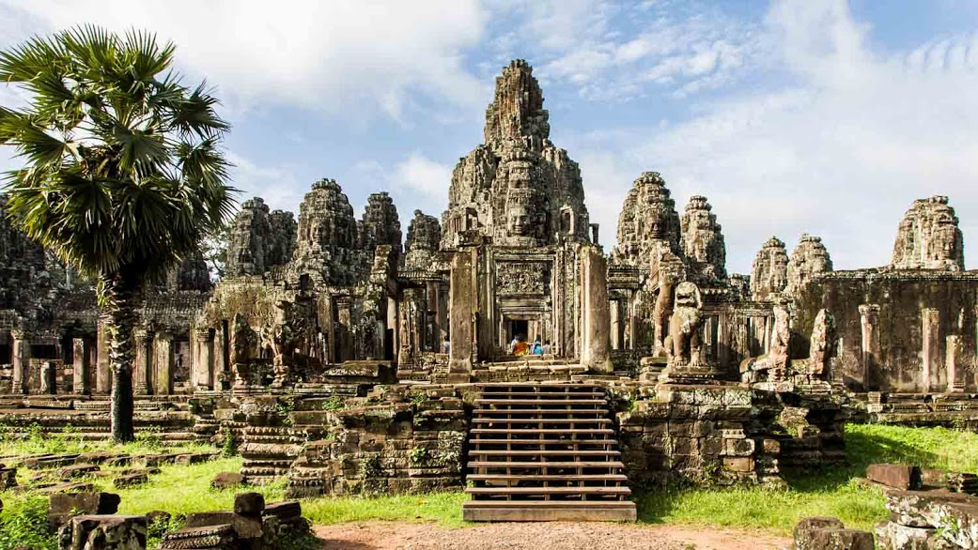
Angkor Wat is a temple complex in Cambodia and the largest religious monument in the world, with the site measuring more than 162 hectares . It was originally constructed as a Hindu temple of god Vishnu for the Khmer Empire, gradually transforming into a Buddhist temple toward the end of the 12th century.

Slide 3
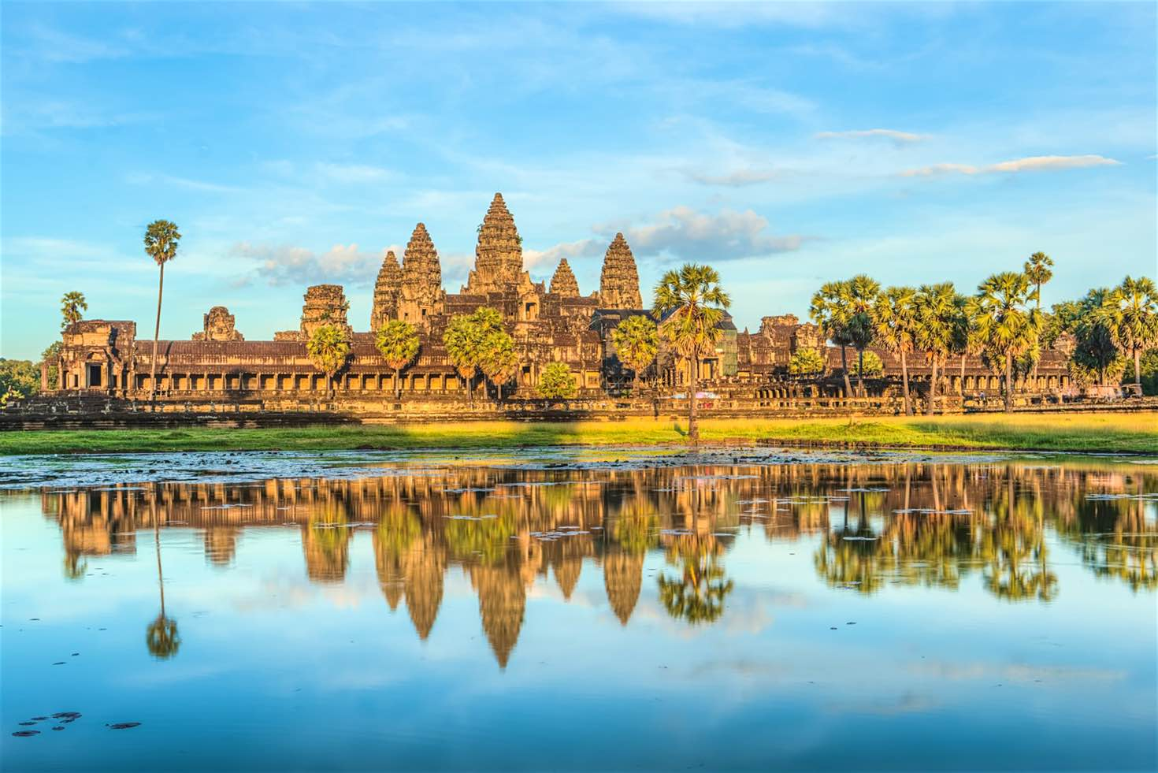
It was built by the Khmer King Suryavarman II in the early 12th century in Yaśodharapura , the capital of the Khmer Empire, as his state temple and eventual mausoleum. Breaking from the Shaiva tradition of previous kings,Angkor Wat was instead dedicated to Vishnu

Slide 4
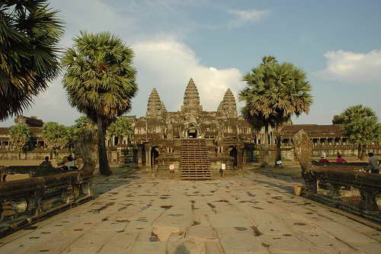
As the best-preserved temple at the site, it is the only one to have remained a significant religious center since its foundation. The temple is at the top of the high classical style of Khmer architecture. It has become a symbol of Cambodia, on its national flag, and it is the country's prime attraction for visitors.

Slide 5
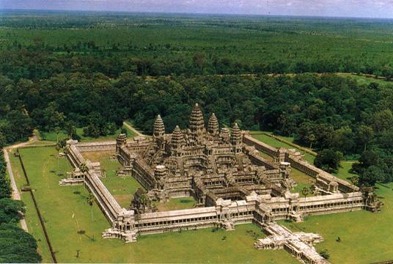
Angkor Wat combines two basic plans of Khmer temple architecture: the temple-mountain and the later galleried temple. It is designed to represent Mount Meru, home of the devas in Hindu mythology: within a moat and an outer wall 3.6 kilometres long are three rectangular galleries, each raised above the next.

Slide 6
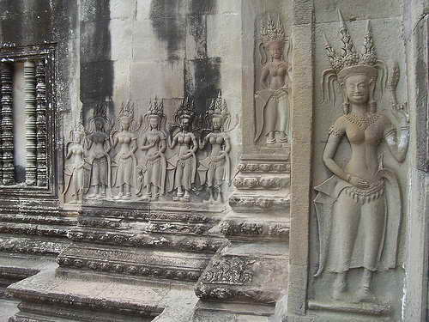
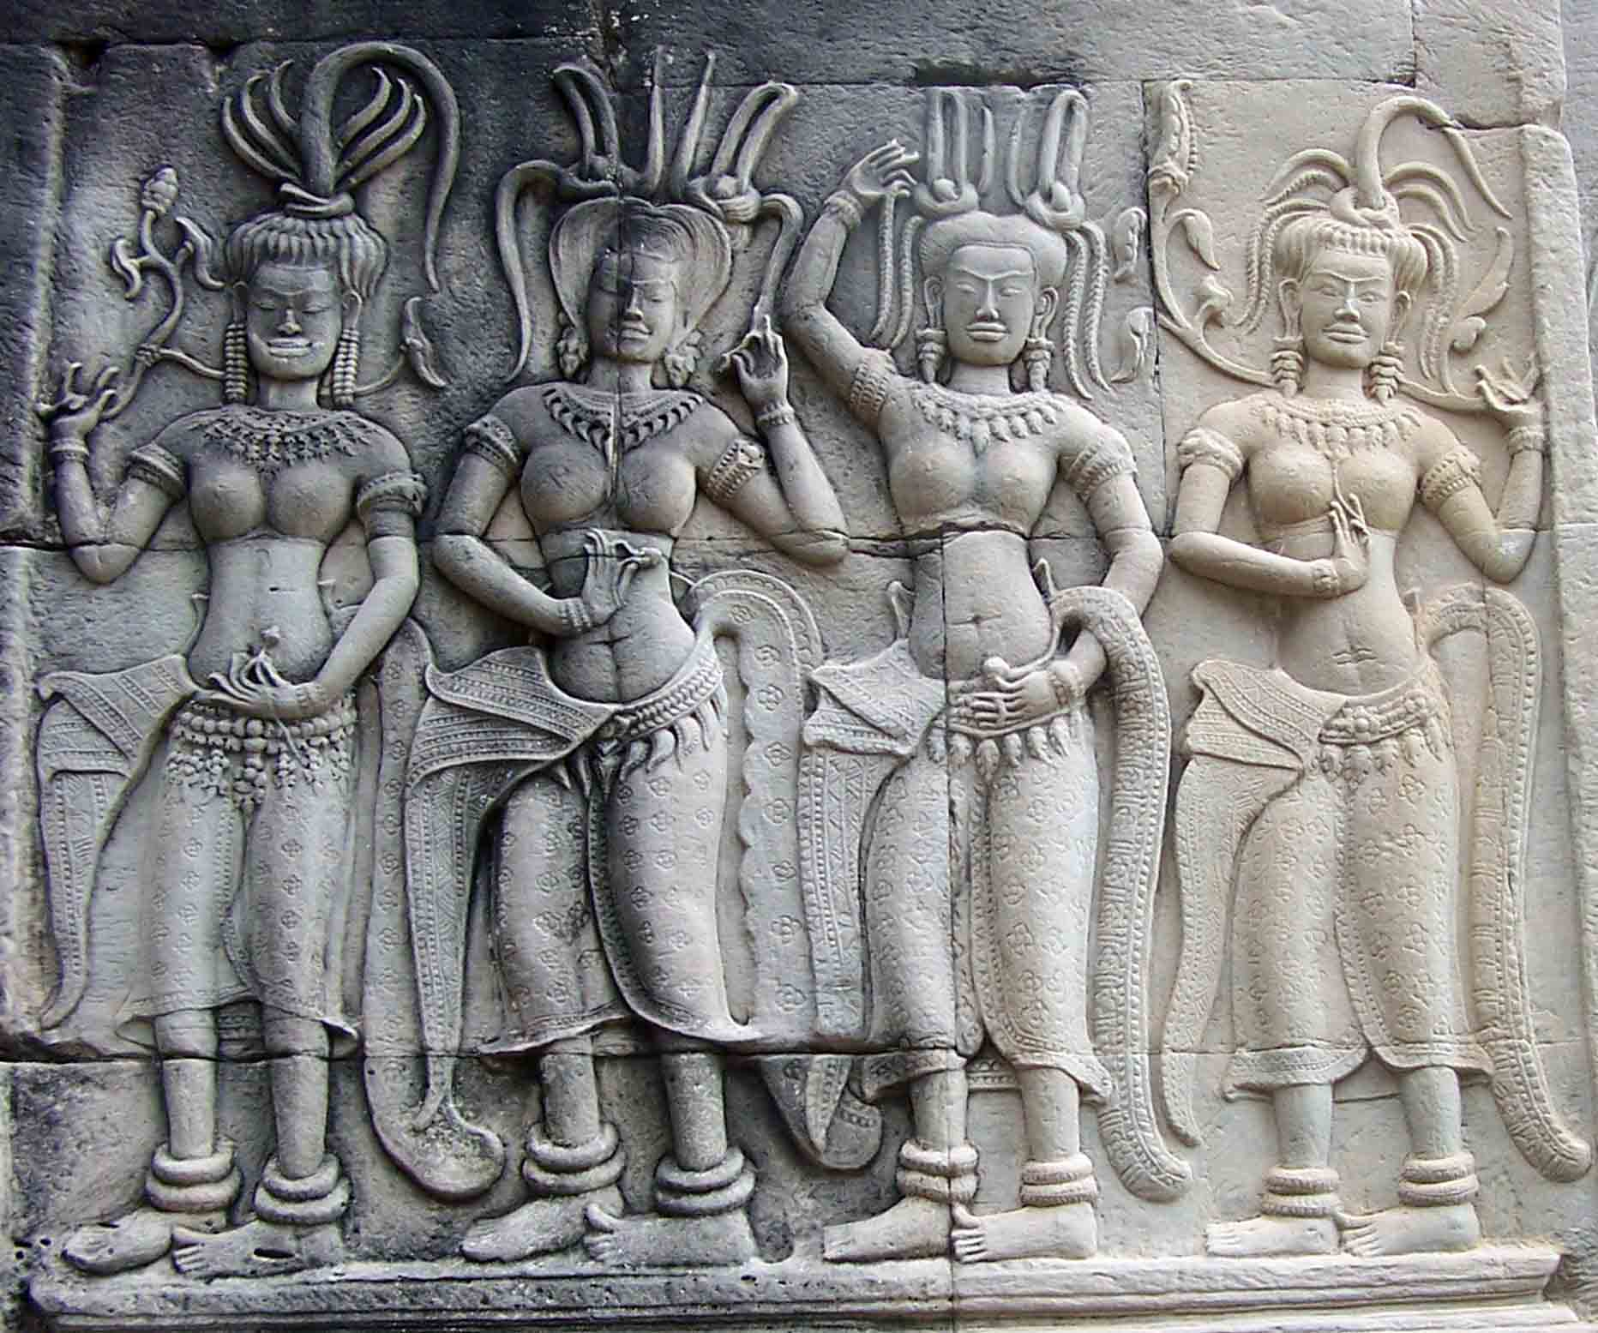
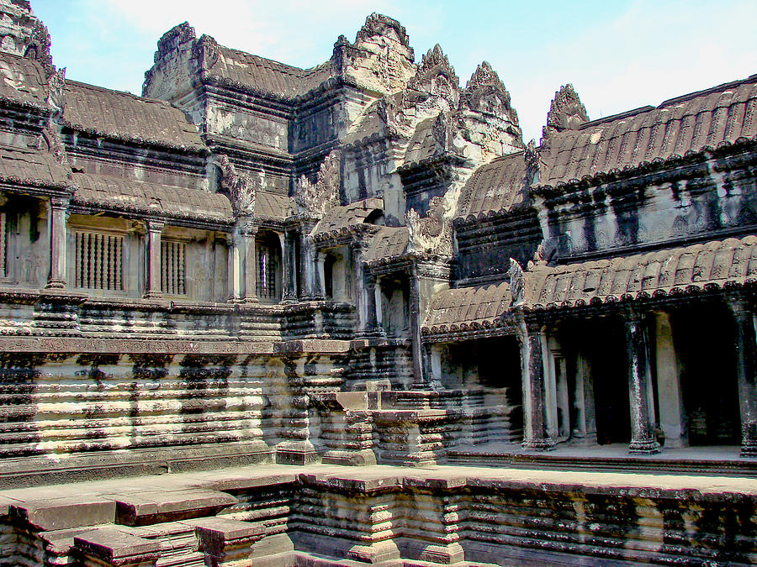
At the centre of the temple stands a quincunx of towers. Unlike most Angkorian temples, Angkor Wat is oriented to the west; scholars are divided as to the significance of this. The temple is admired for the grandeur and harmony of the architecture, its extensive bas-reliefs, and for the numerous devatas adorning its walls.
https://www.youtube.com/watch?v=8pLMCHNHHgU

Slide 7
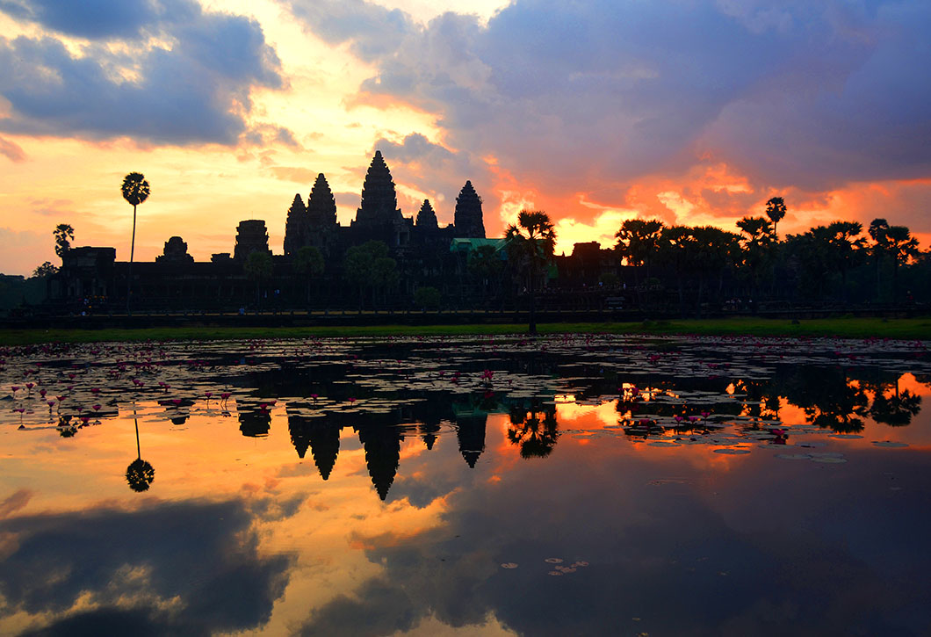
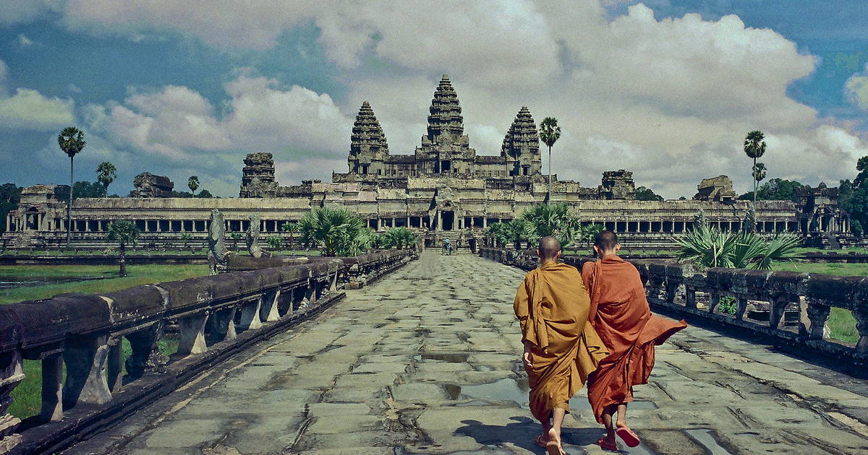
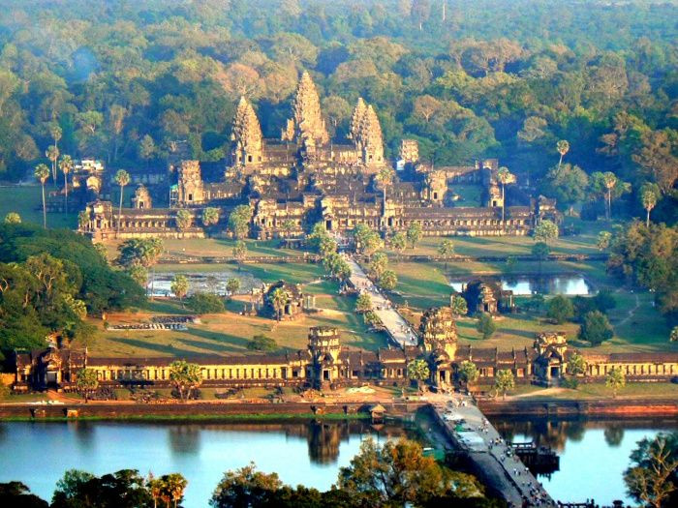
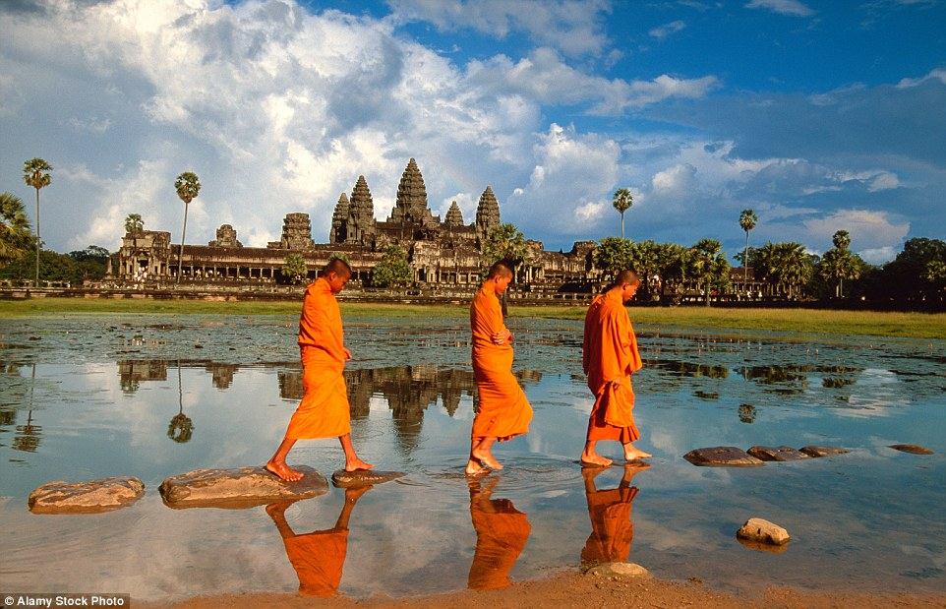
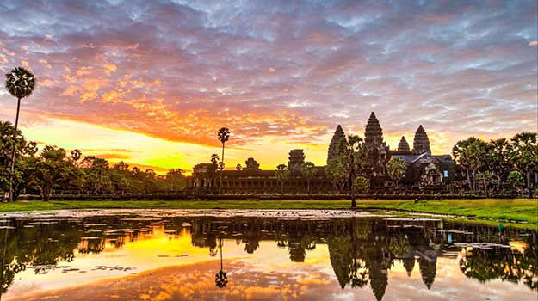

Slide 8
Preslava mariya radova

