Slide 1
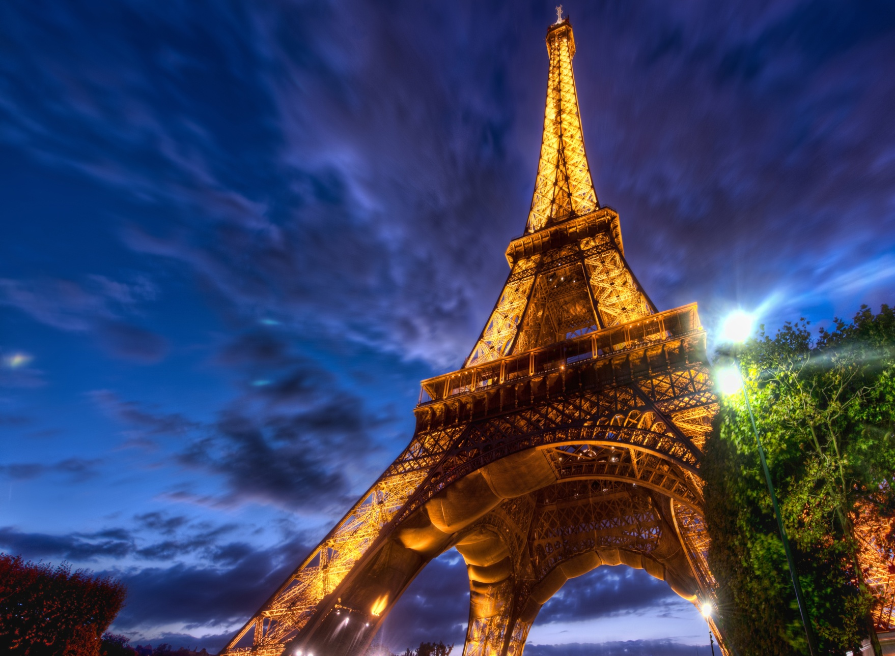
Eiffel Tower

Slide 2
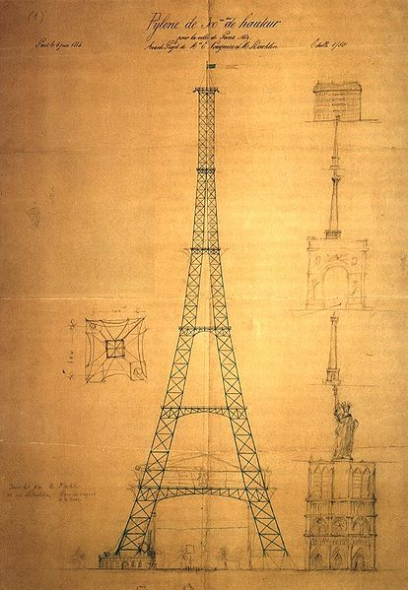
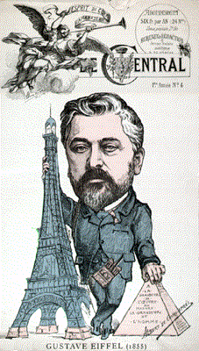
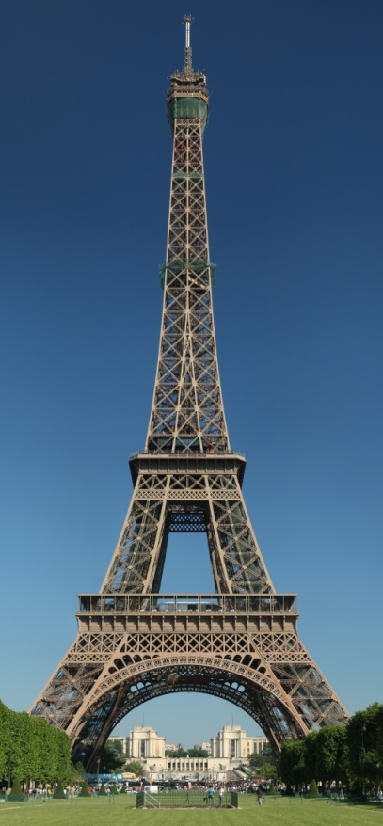
The Eiffel Tower is an iron tower in Paris. It was named of the engineer Gustave Eiffel, whose company designed and built the tower.
Eiffel Tower
*compare
сравнявам,
сравнение
Caricature of Gustave Eiffel comparing* the Eiffel tower to the Egipet Pyramids.
First drawing of the tower by Maurice Koechlin.

Slide 3
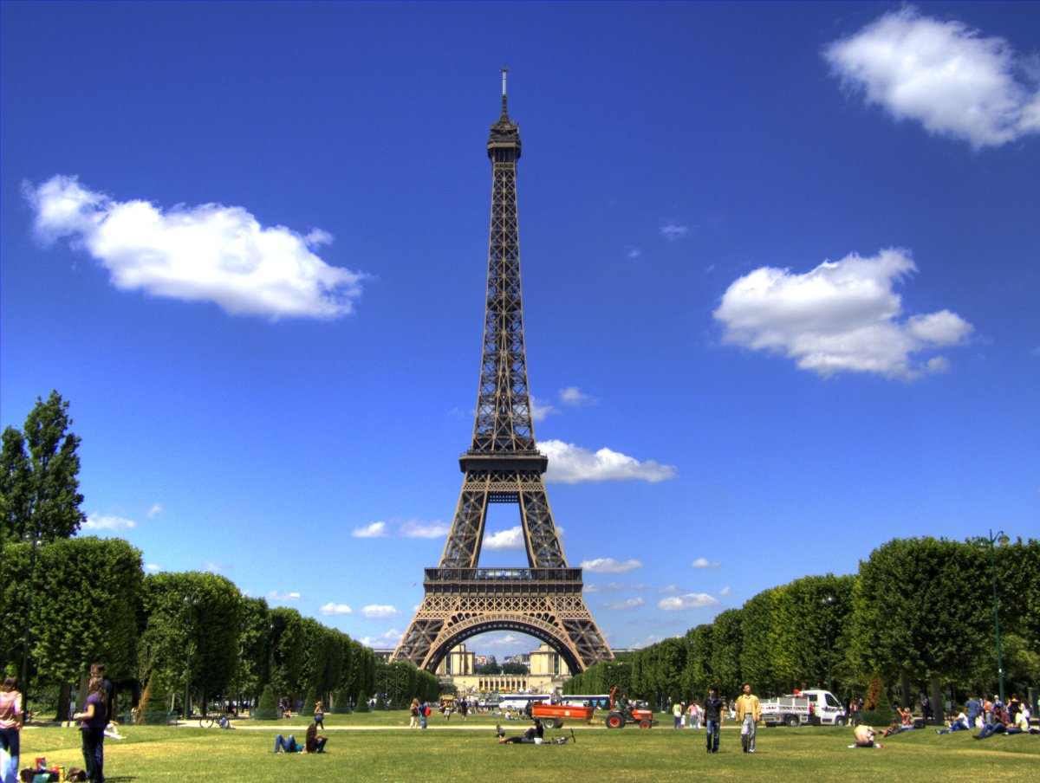
The construction* of the tower started in 1887 and finished in 1889. The atraction* was open officially* for visitors at 31 March 1889.
*construction – строеж; *atraction – атракция; *officially - официално

Slide 4
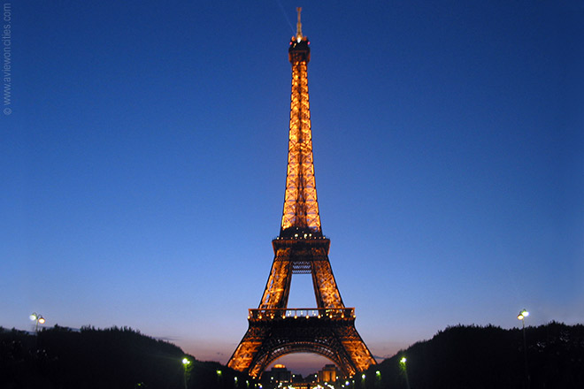
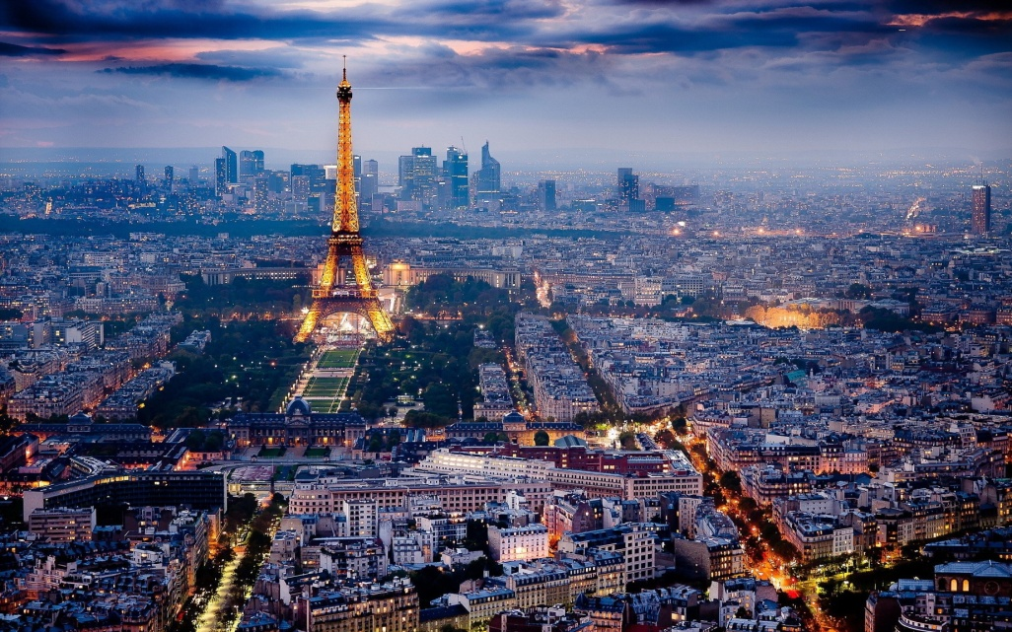
The tower is the tallest structure in Paris - 324 metres, about the same height as an 81-storey building and the most-visited paid monument in the world.
Paris
324 m

Slide 5
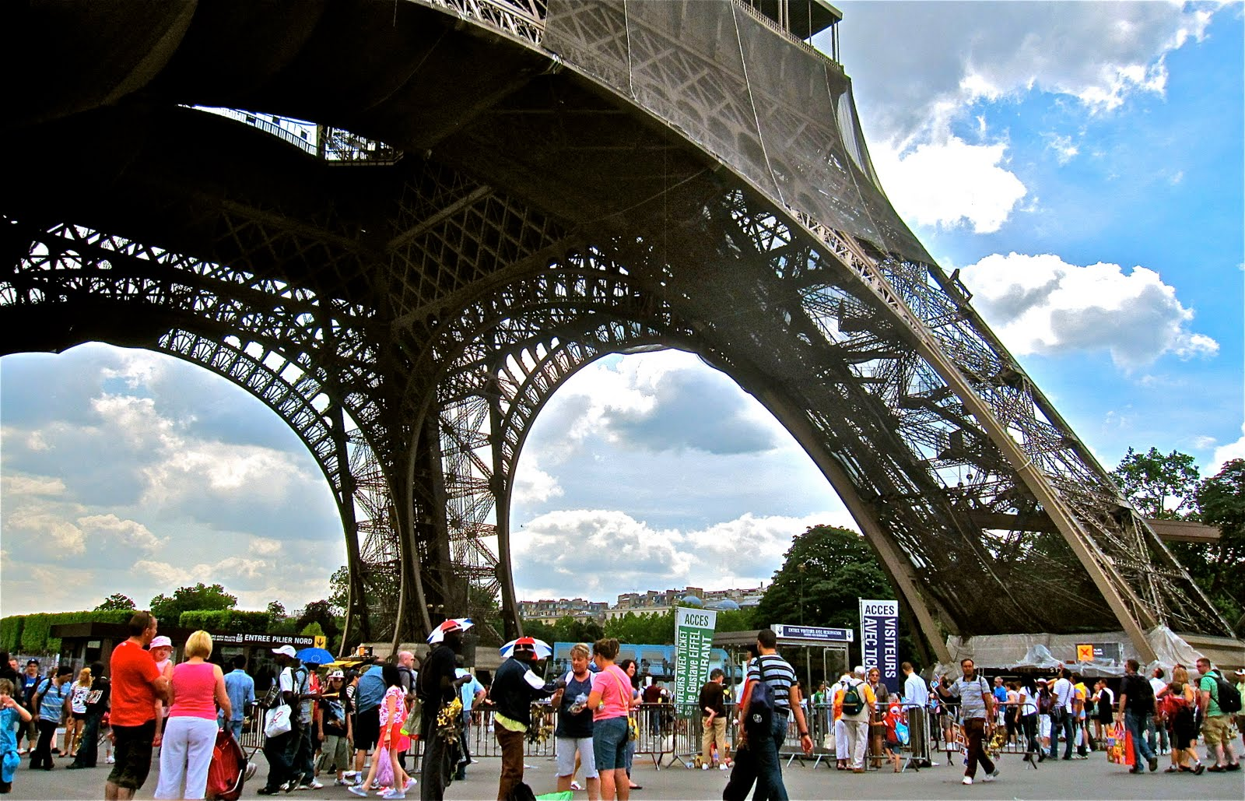
The tower is very famous monument in the world. The tower received* the 250 millionth visitor in 2010. 6.98 millions tourists have visited the Eifell tower only in 2011.
*receive – получавам, приемам

Slide 6
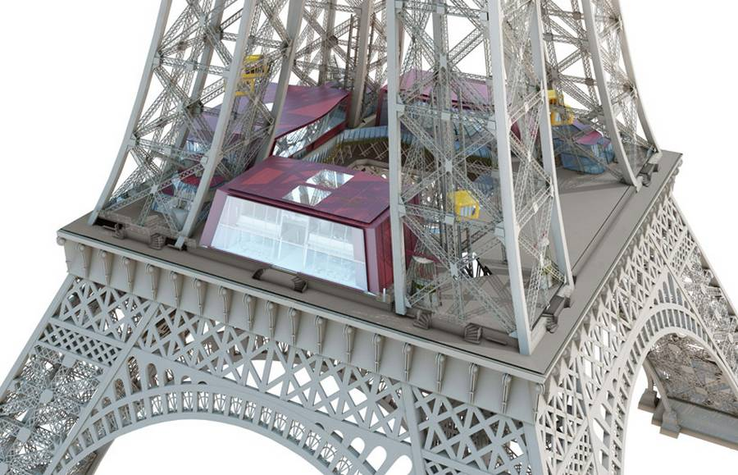
The tower has three levels for visitors, with restaurants and coffees on the first and second. They can be reached* by staircase* or lift*, but third level can be reached only by lift.
First Level
*reach – достигам, стигам;
*straircase – стъпала, стълбище; *lift - асансьор

Slide 7
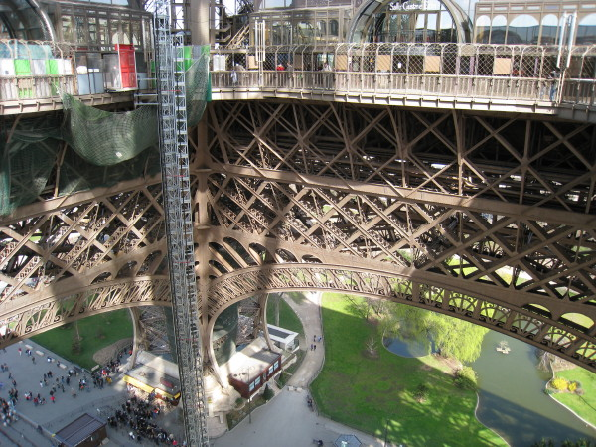
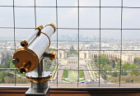
There is an observatory* on the third level – 276 meters above the ground. This is the highest place for access* of the people in European Union.

Slide 8
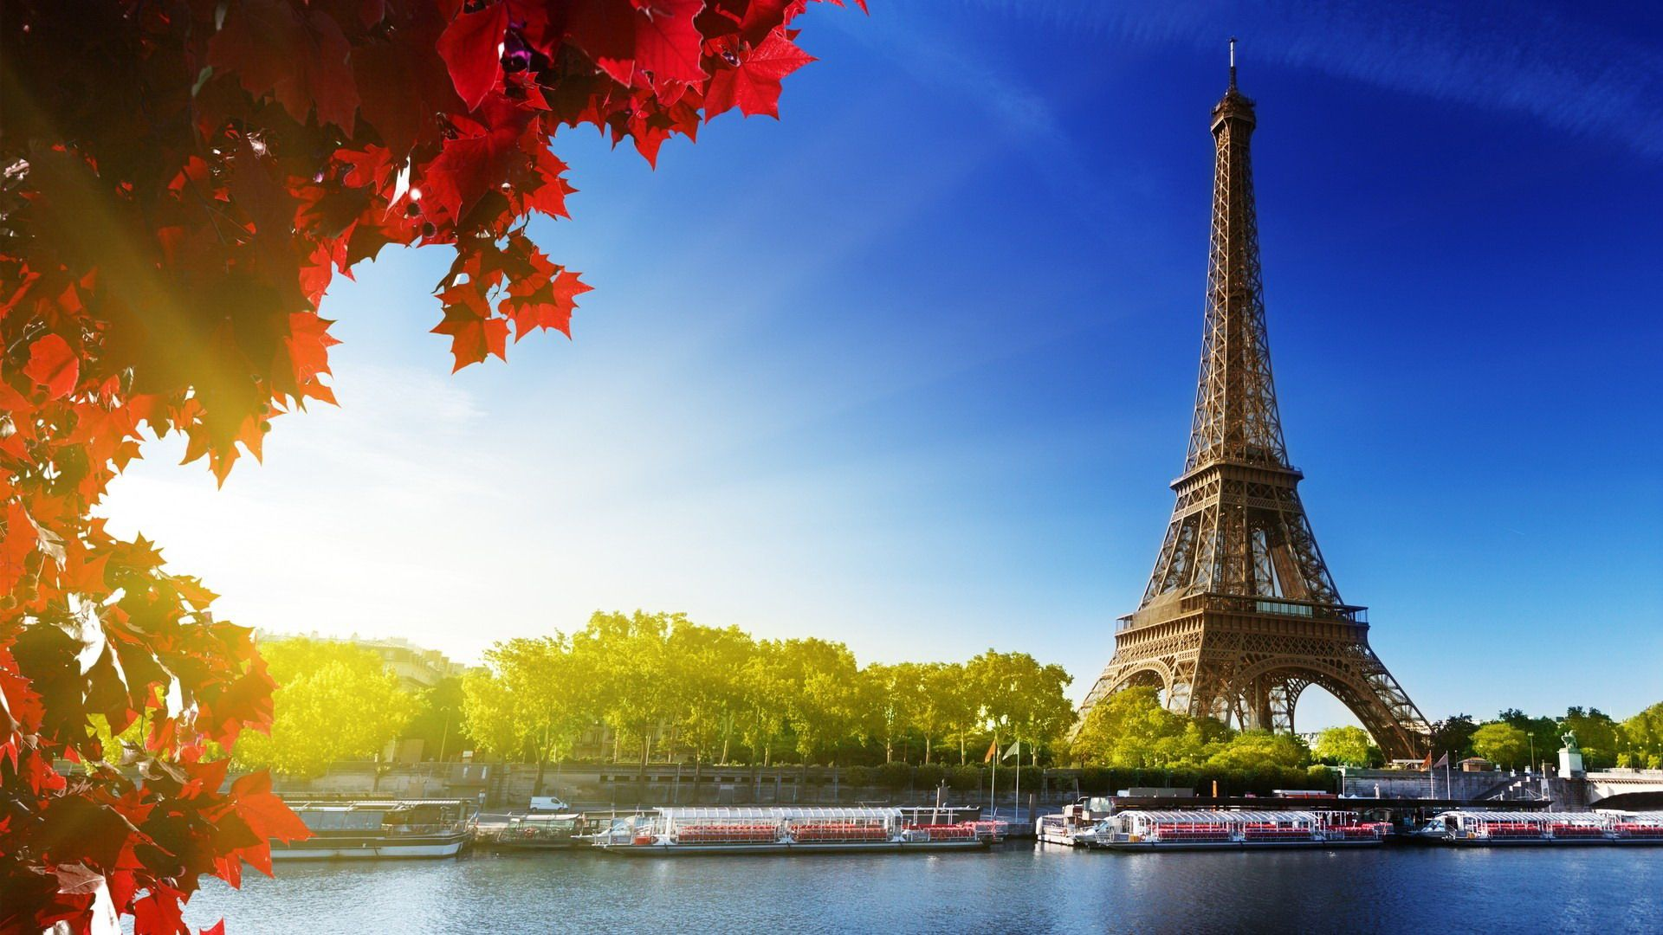
THANK YOU!
Made by:
Tsvetin Krastev
VI “b” class

