Slide 1
Food
Andreq Nedkova VI b

Slide 2
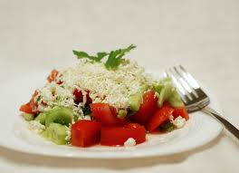
Salads
Shopska salad contains cucumbers, tomatoes , garlic, and cheese . This salad is healthy and traditional Bulgarian salad.
1.Shopska salad

Slide 3
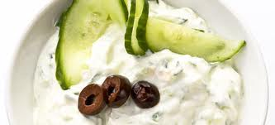
Salads
2.Snejanka salad
Snejanka salad contains cucumbers and milk. This is my favorite salad!
Notes:
2.Snejanka salad

Slide 4
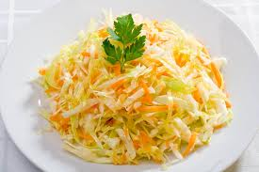
Salads
3.Salad cabbage and carrots
In this salad has cabbage, carrots, olives, and parsley.

Slide 5
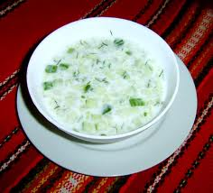
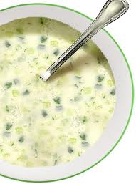
Soups
The tarator is cold soup which contains cucumbers, garlic, milk and dill.
1.Tarator

Slide 6
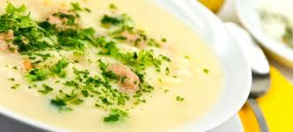
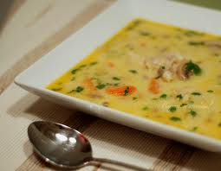
Soups
2.Chicken soup
This soup contains vegetables, milk, chicken, eggs and vermicelli.

Slide 7
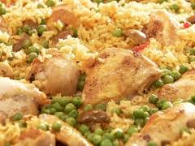
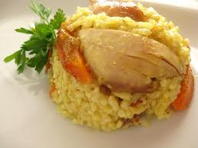
Meat
1.Chicken with rice
This is very delicious food. I love it! The chicken and rice always contains chicken and rice.

Slide 8
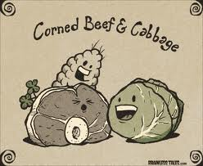
Meat
2. Beef with cabbage
Do you know what the beef with cabbage contain?
This is very easily this recipe contains beef and cabbage =D

Slide 9
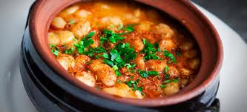
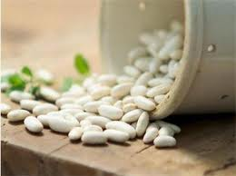
Traditional Bulgarian recipes
1.Beans
Recipe for beans: beans, onion, vegetables, and sometimes some meats.

Slide 10
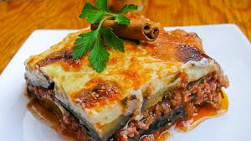
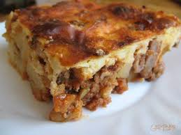
Traditional Bulgarian recipes
2.Moussaka
Moussaka contains potatoes, meat, and vegetables. This is delicious traditional Bulgarian recipe.

Slide 11
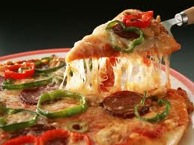
Fast food
There are many recipes of pizza. Some of these recipes are: Chicken Surprise, Hot and Spy, Meat Feast, Hawaiian, Vegetarian, Create your own.
1.Pizza

Slide 12
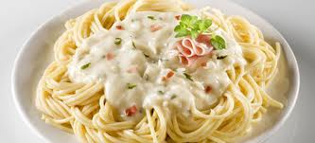
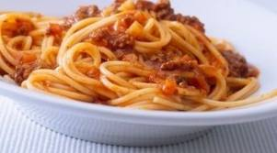
Fast food
2.Spaghetti
Each kind of spaghetti contains spaghetti. The most famous recipes of spaghetti are: bolognese, carbonara, and other.

Slide 13
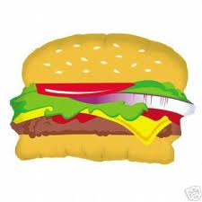
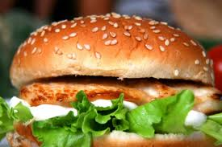
Fast food
Most hamburgers contains meat, onion, cabbage, tomatoes, cucumbers and cheese.
3.Hamburger

Slide 14
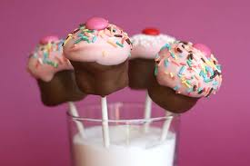
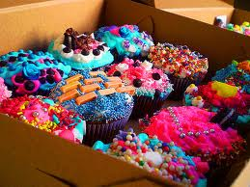
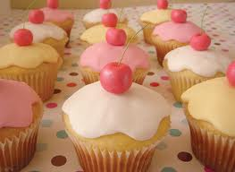
Desserts
1.Muffins and cupcakes

Slide 15
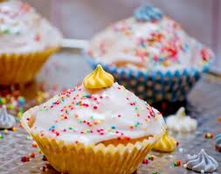
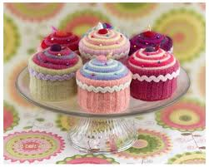
Desserts
Muffins and cupcakes are very sweet delicious desserts. Some recipes contains milk, sugar, cream, flour, nuts, chocolate and the very important are sugar sticks.

Slide 16
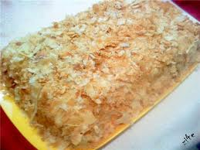
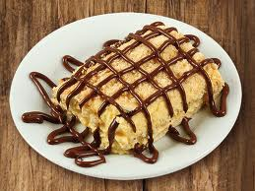
Desserts
2.Grandmother cake
The recipe for Grandmother cake: eggs, sugar, flour, walnuts, cocoa, and vanilia.

Slide 17
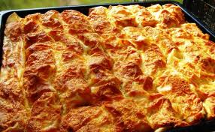
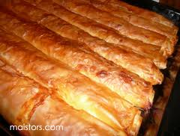
Other
1.Pasty
This recipe is salty. Pasty contains eggs, milk, cheese, water, and peel.

Slide 18
The end

