Slide 1
Stephen Hawking
Famous people

Slide 2
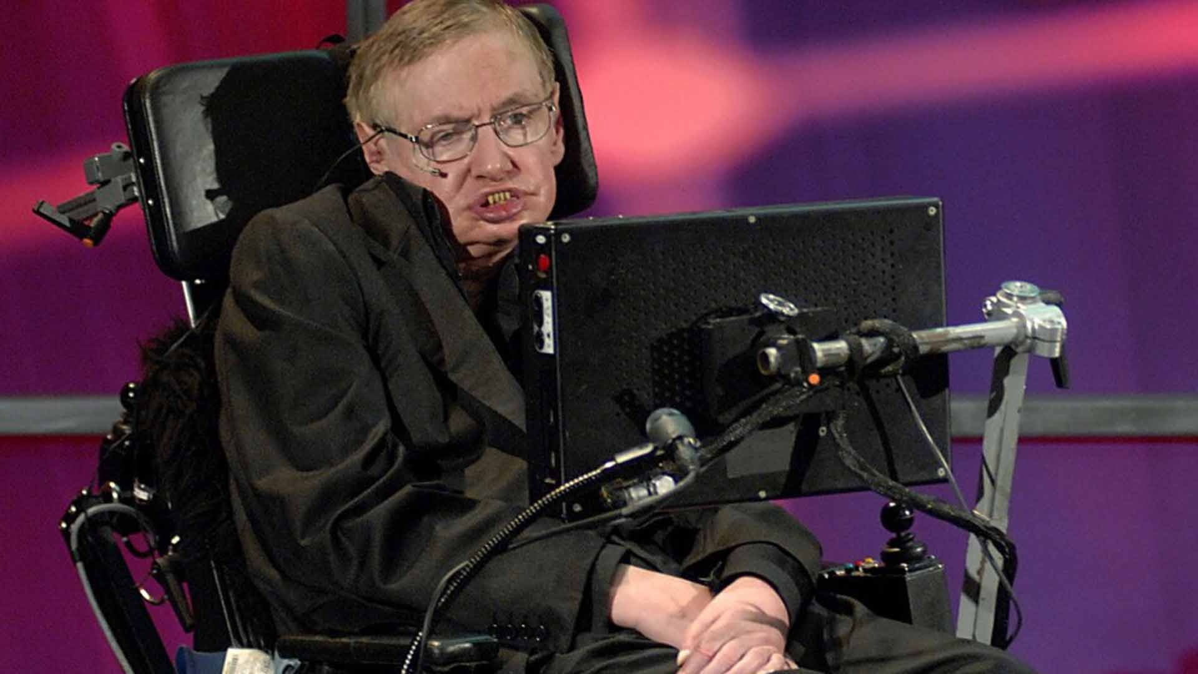
Who is Stephen Hawking?
Stephen Hawking is one of the most brilliant scientists in the 20th century. He is from Oxford, England. In 1962 he went to study in Cambridge. He was an incredible student. But one day in university, Hawking falls on the floor. He went to the doctors and there they told him he has a amyotrophic lateral sclerosis.

Slide 3
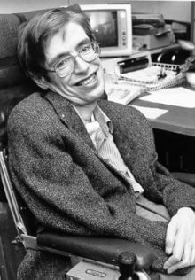
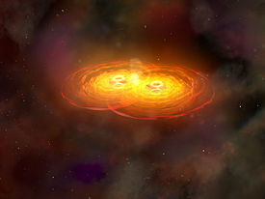
Why Stephen Hawking is famous?
After being diagnosed with motor neuron disease, Hawking fell into a depression. But one day he looked at the mirror and told himself that he must live with this ill. And he did just that. In 1970, Hawking postulated what became known as the second law of black hole dynamics. This law explains that the event horizon of a black hole can never get smaller.

Slide 4
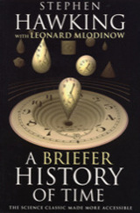
A Briefer history of time
Stephen Hawking has a lot of theorems about universe. He wrote a lot of books and the most popular of them is “A Briefer History of Time”, which was sold in more than 10 millions copies.

Slide 5
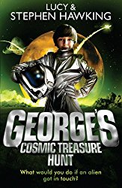
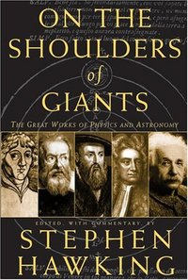
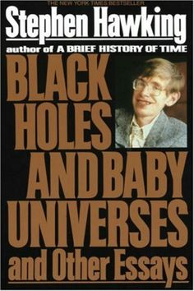
Stephen hawking books

Slide 6
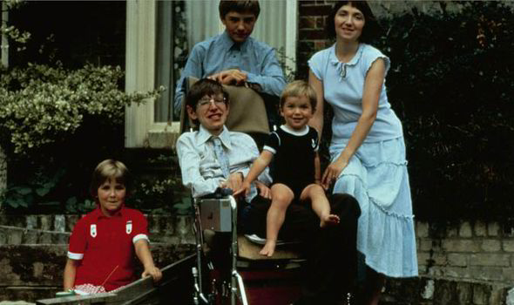
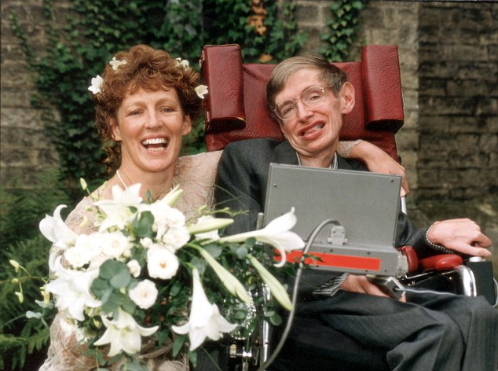
Family
When Hawking was a student at Cambridge, his relationship with Jane Wilde continued even after the diagnosis. In 1965 they married. They have three children but in 1990 he married again for Elaine Mason.

Slide 7
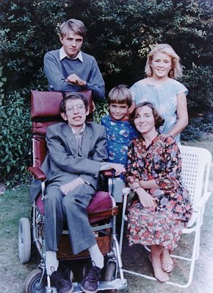
The Hawking children

Slide 8
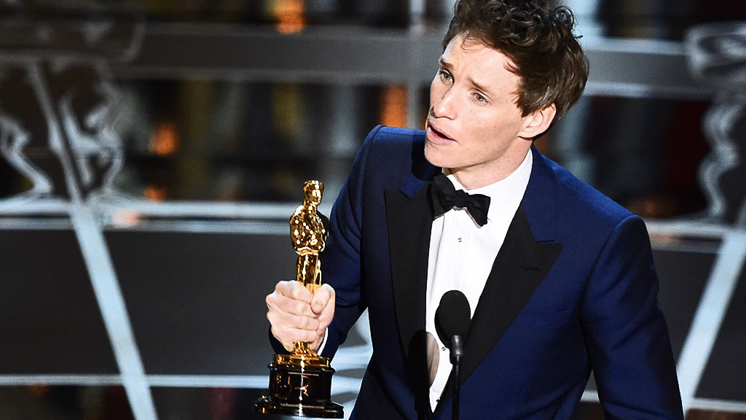
The movie
In 2014 a movie was made about Stephen Hawking called The Theory of Everything. The actor, who played Hawking was Eddie Redmayne and he won a Oskar for this movie and his role in it.

Slide 9
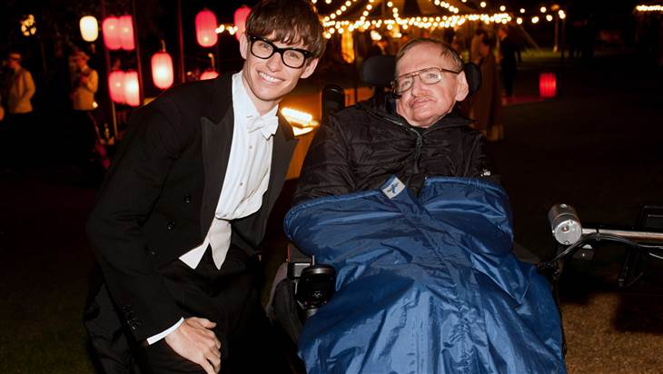
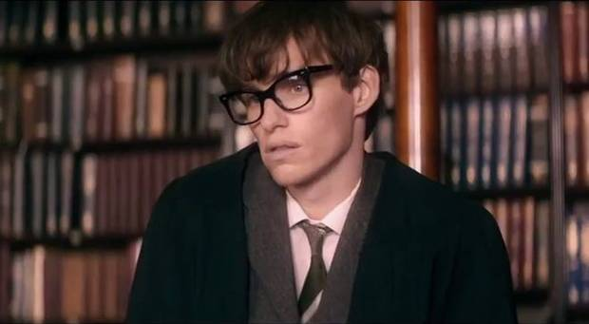
You have to watch this movie!

Slide 10
The end!
from: Nadya 7g class

