Slide 2
X Factor in Bulgaria
X Factor Bulgaria is Bulgarian television music show in British production owned by Fremantle Media and produced by Simon Cowell - The X Factor. Broadcast in 33 countries, including Bulgaria and - since 2004.
The transmission is in the program of Nova TV. The first episode was broadcasted, is September 11, 2011, producers are Paprika Latino.
In the first season Jury (mentors) consists of Vasko Vassilev, Poli Genova, Maria Ilieva and Aliev Magomed-Maga. Leading is Deo.
In second and third season: Maria Ilieva, Lubo Kirov, Sanya Armutlieva, Velizar Sokolov (Zaki).

Slide 3
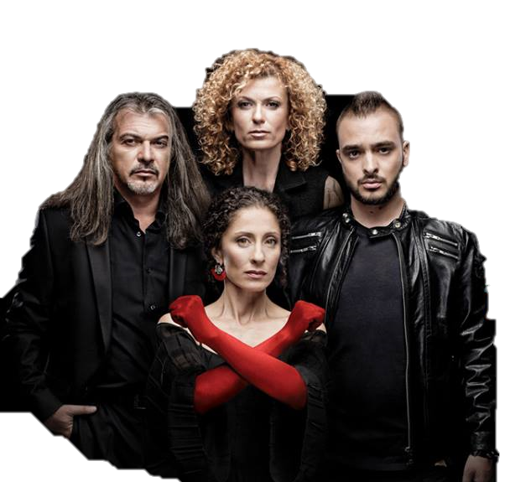
X Factor 2015
Mentors(Jury)

Slide 4
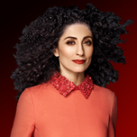
Stanislava Armutlieva (Sanya)
Sanya was born on May 30, 1971.
For over 20 years Stanislava Armutlieva is the head of one of the largest and most prosperous music companies in Bulgaria - "Virginia Records". In her catalog includes hundreds of recordings and videos of Bulgarian performers.
Long experience of Sanya in the music business helped her discern unmistakable talent that possess X Factor, and to ensure a strong start and develop their careers. Among produced by "Virginia Records' artists are now the winners in the first three seasons as Rafi, Jana Bergendorff and Slavin Slavchev talents from the last edition of the show Nevena Peykova , Michaela Marinova, Plamen and Ivo Dobrev, Luba Ilieva, Kristina Doncheva and duet Pavell & Venci Venc. A major role for the professional look of Sanya Armutlieva has as its partnership with the team of Simon Cowell and his company SyCo, and its operation over the years with the Titans in the recording industry Sony Music, Universal Music and EMI.

Slide 5
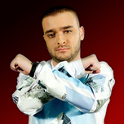
Kristian Talev (Krisko)
Kristian Talev was born in Sofia, but grew up in Gabrovo, in a family of musicians. His career began with children's music programs. He is then called "The Lion King" show "Like the lions.“
He began as a member in the local music band. Over the years he began to make songs for various artists. Miro former duet "Karizma" noticed his talent and made several joint projects. In 2008 he worked as a sound engineer on "Radio 1, and in 2009 and 2010 working with Spence as a music producer and performer in his label.
Successful in 2015 is part of the jury of X Factor as a mentor girls.
We have own studio - Krisko Beats, where he developed both their projects and those of emerging artists.

Slide 6
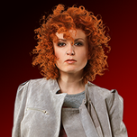
Lucy Diakovska
Lucy was born in Pleven, Bulgaria. She was the first child in a family already famous Diakovski. Her mother was a pianist, her father - an opera singer. Her grandfather is one of the most famous folk composers. Even before start talking already played on stage. Six years was its first appearance in the opera with her father.
Then immediately decided that he wanted to deal with classical singing. When 14 years Separate sang his first song in public and & # 768 became clear that he wants to conquer the world with his own music. After graduation in 1995, he left Bulgaria. He moved to Hamburg, Germany to study at the "Stage School of Dance & Drama" (a specialized school for dance and drama). Arrives in Germany with 500 DM; almost does not know German. In order to finance his studies, worked in the musical " Buddy ", which received a commitment immediately after his graduation in 1997.

Slide 7
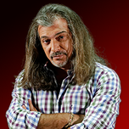
Magardich Halvadjian
Magardich Halvadjian is Bulgarian director and producer of Armenian origin.
Born on February 18, 1967 in Pleven. He lived in Varna, in various Italian cities and in Moscow, where he taught school for circus artistry in the period from 1981 to 1986 [1] He graduated directing at New Bulgarian University. In his youth he played in a group. Owner of the production company "Global Films" and "Global Vision".
There are over 450 videos and commercials shot and is one of the most successful in the producer's business. With production deals from the mid 90s. His company "Global Dream" has existed since 2002. His are some of the most popular shows
In 2010 and 2012 the jury of the reality show "Bulgaria's Got Talent" TV BTV.
Now, in 2015, a jury in X factor.

Slide 8
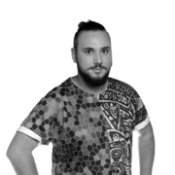
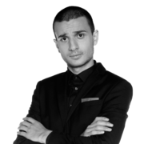
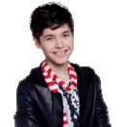
Sanya’s team
Kristian Yankulov
Zhivko Stanev
Christian Kostov

Slide 9
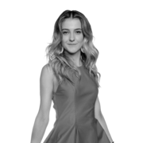
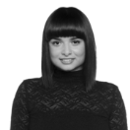
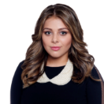
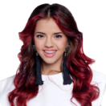
Krisko’s team
Angela Kirkova
Victoria Georgieva
Darina Jotova
Eva-Mariq

Slide 10
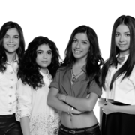
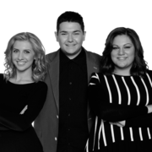
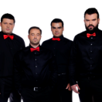
Lusi’s team
Trio Paradise
Salute
Belcanto
A.V.A

Slide 11
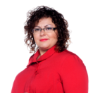
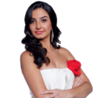
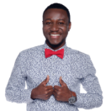
Magi’s team
Alexandrina Makendzhieva
Kristiana Loizou
Steven Achikor

Slide 12
My favorites are…
AND
Kristiana Loizou
Darina Yotova

Slide 13
BY Gabriela Mincheva,6 d class, № 4

